Slide 1
Cavitation
Vishnu Vijay
vijay97vishnu@gmail.com

Slide 2
Objective
The objective of this study is to analyse the cavitation process in an orifice meter.

Slide 3
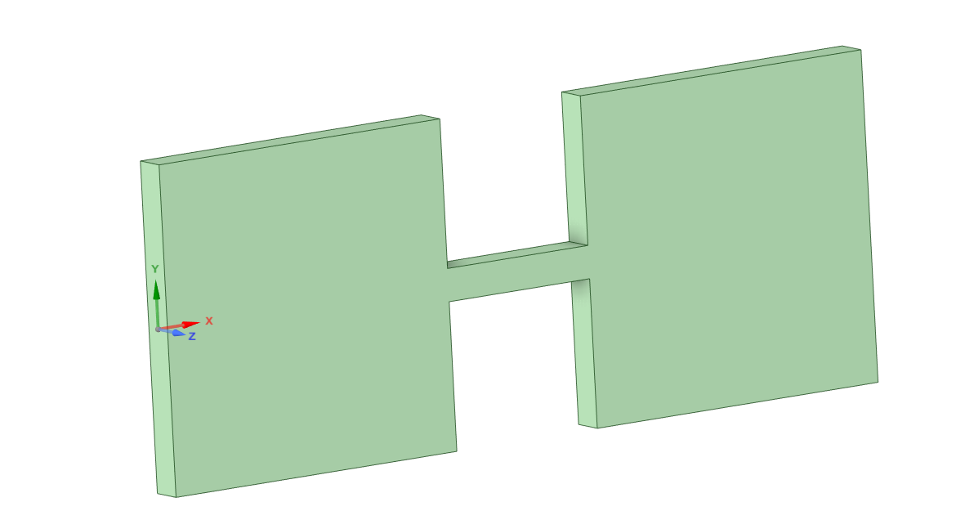
Geometry
walls
Outlet
Orifice
Inlet
Figure: Orifice geometry

Slide 4
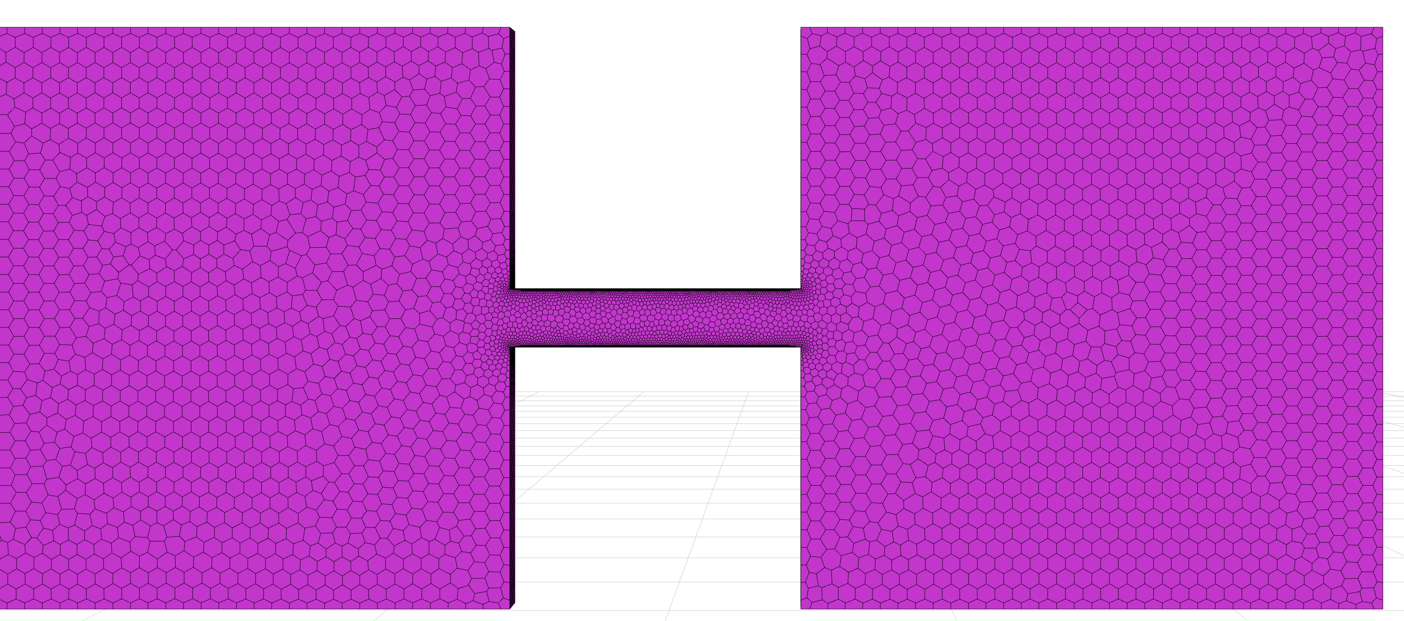
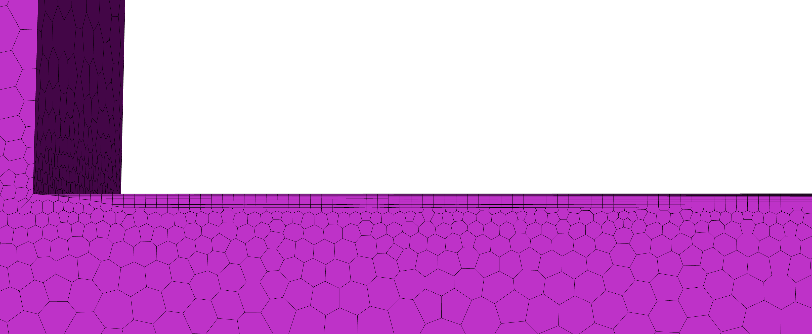
Mesh
Mesh Details
Local sizing(face sizing) | yes
Orifice_wall | 0.244mm
Max-surface size | 3mm
Boundary layers | 8
Offset method type | Smooth transition
Transition ratio | 0.272
Growth rate | 1.2
Cell type | Polyhedra
Figure: Mesh
Figure: Boundary layers

Slide 5
Solver
Solver details
Material properties | Fluid: water at 25C Density water : 997 kg/m3 Viscosity water:0.001003kg/ms
Operating Pressure | 0 Pa
Turbulence | Inlet Specification: intensity & Length scale Turbulent intensity : 5% Turbulent viscosity ration: 0.01m
Turbulence model | SST k omega
Solution Methods | Pressure velocity coupling scheme: Coupled
Initialisation | Hybrid
Time step method | Automatic
Number of iteration | 1000
Boundary Conditions
Pressure Inlet | 3.5e5 Pa
Pressure outlet | 3,2.5,2,1.5,1,0.5,0 Pa
wall | wall

Slide 6
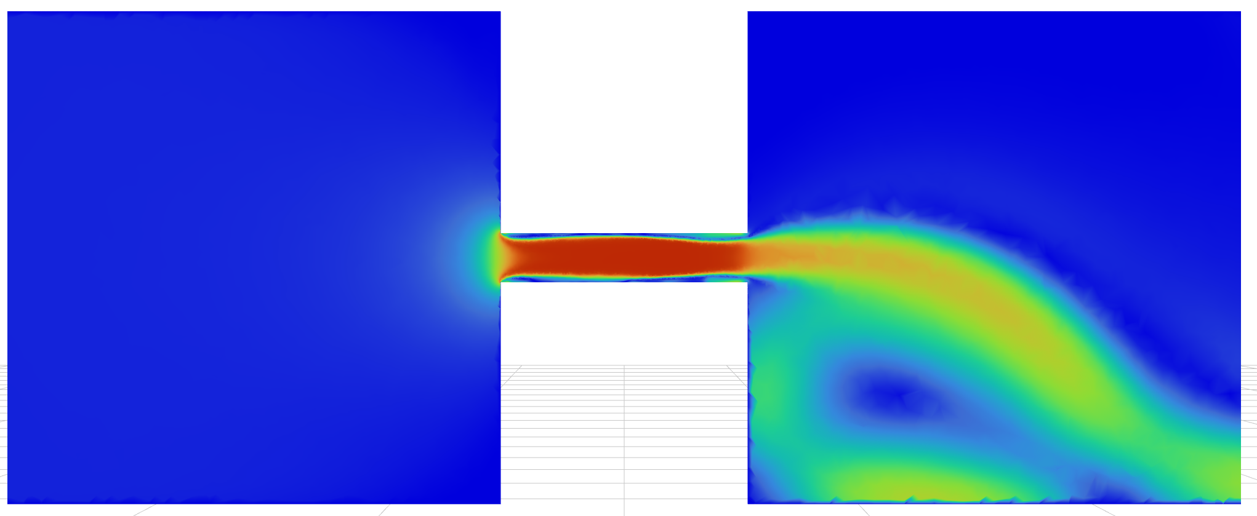
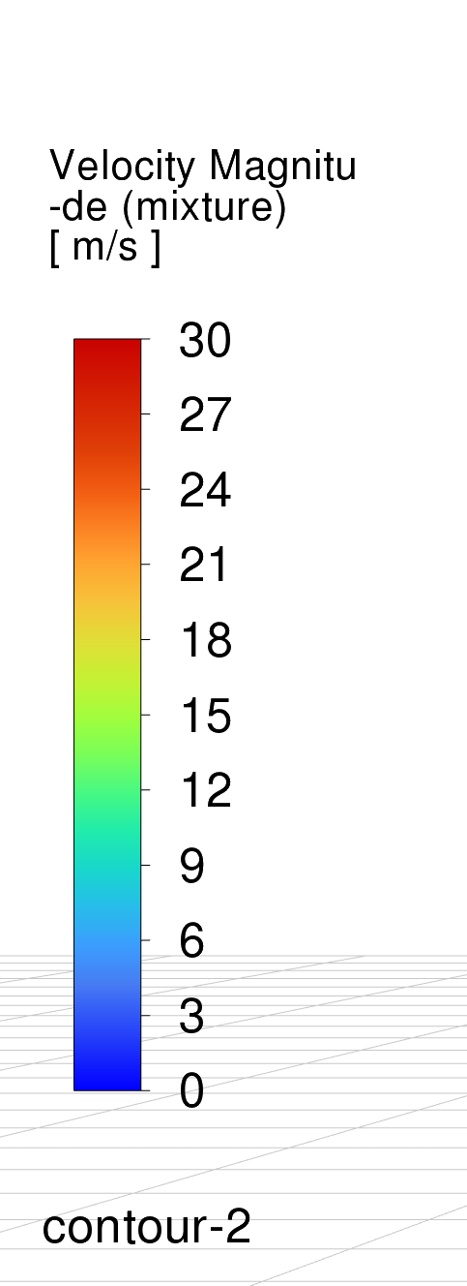
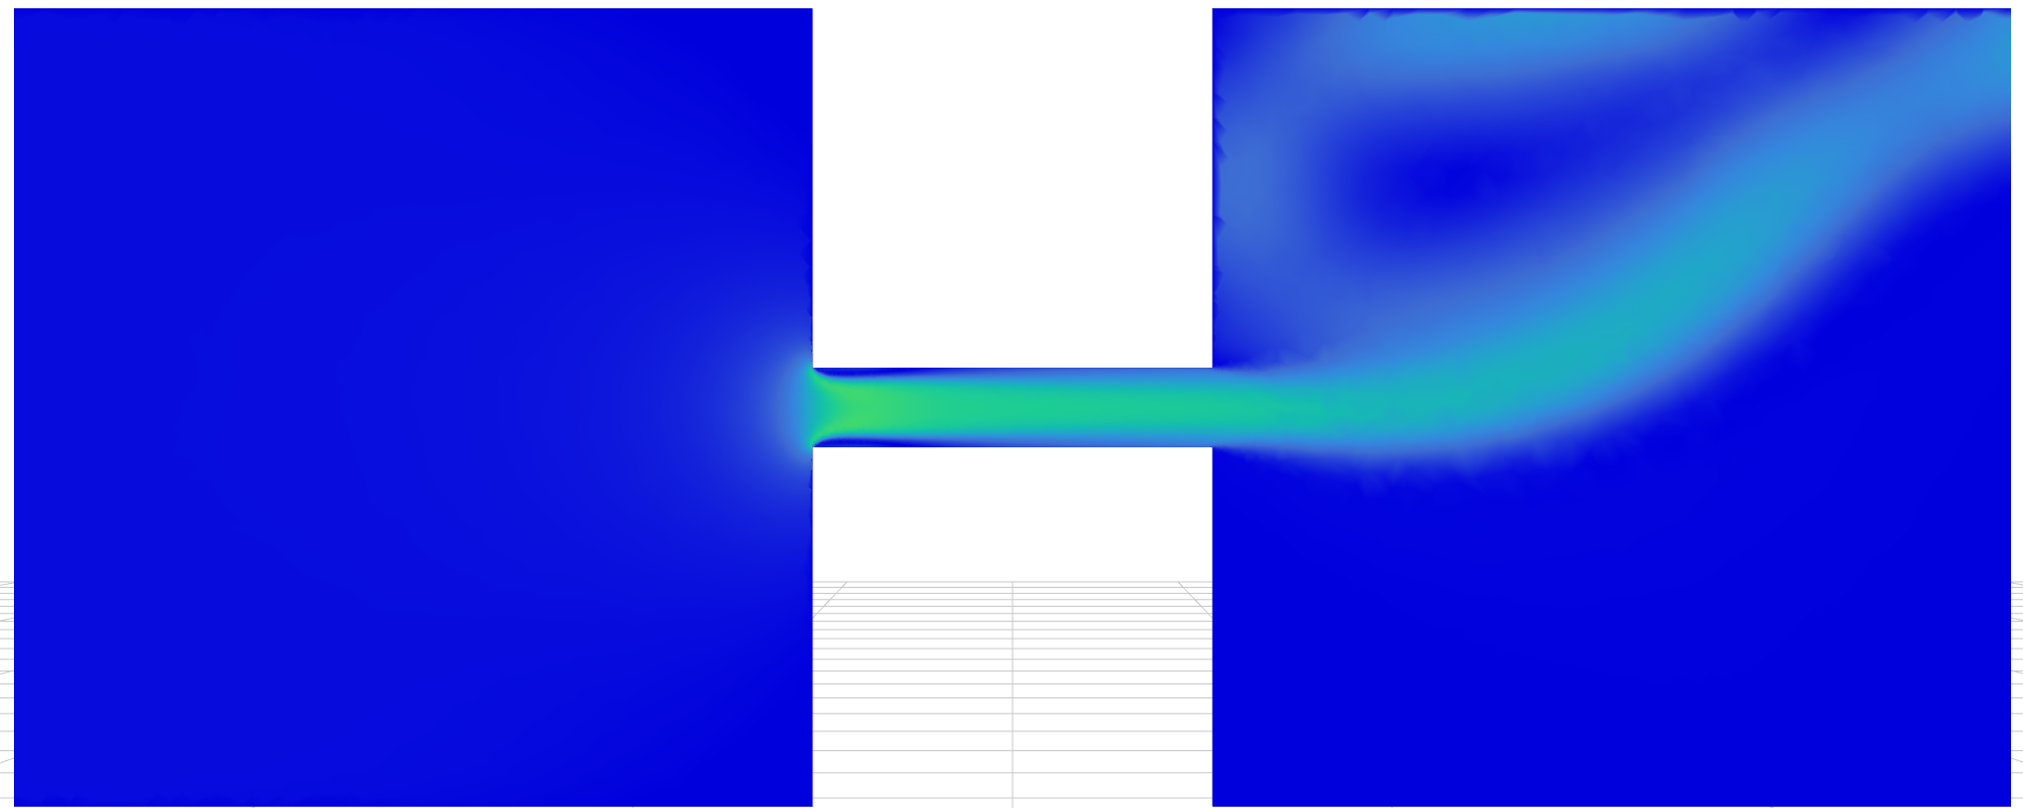
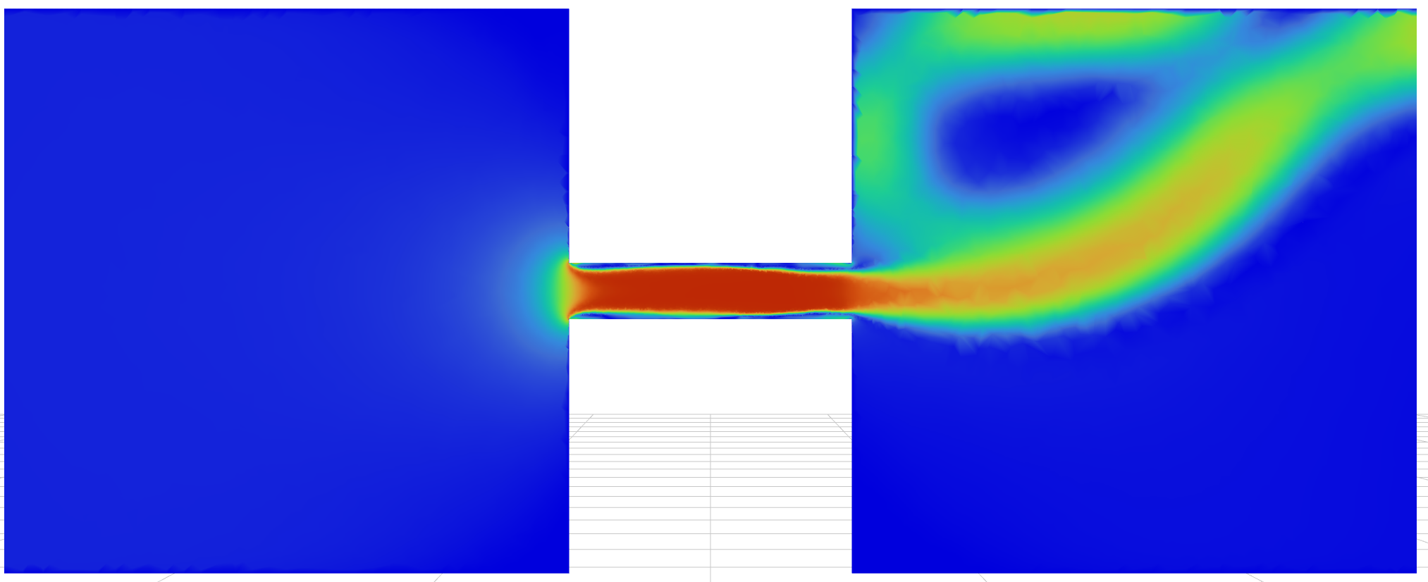
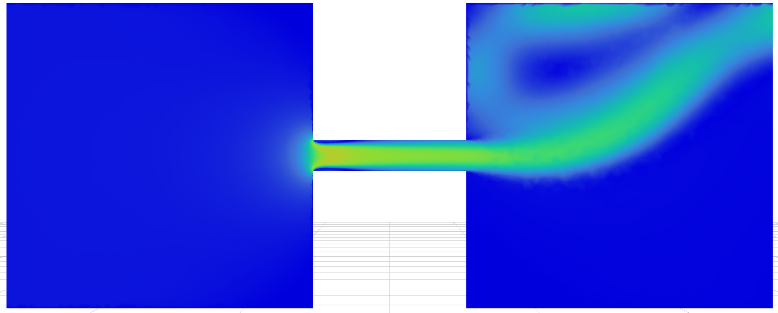
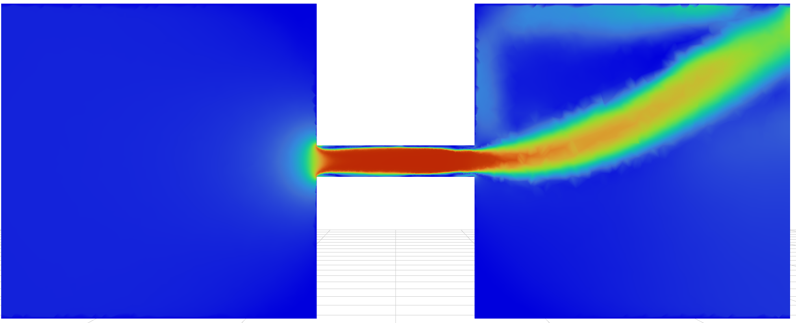
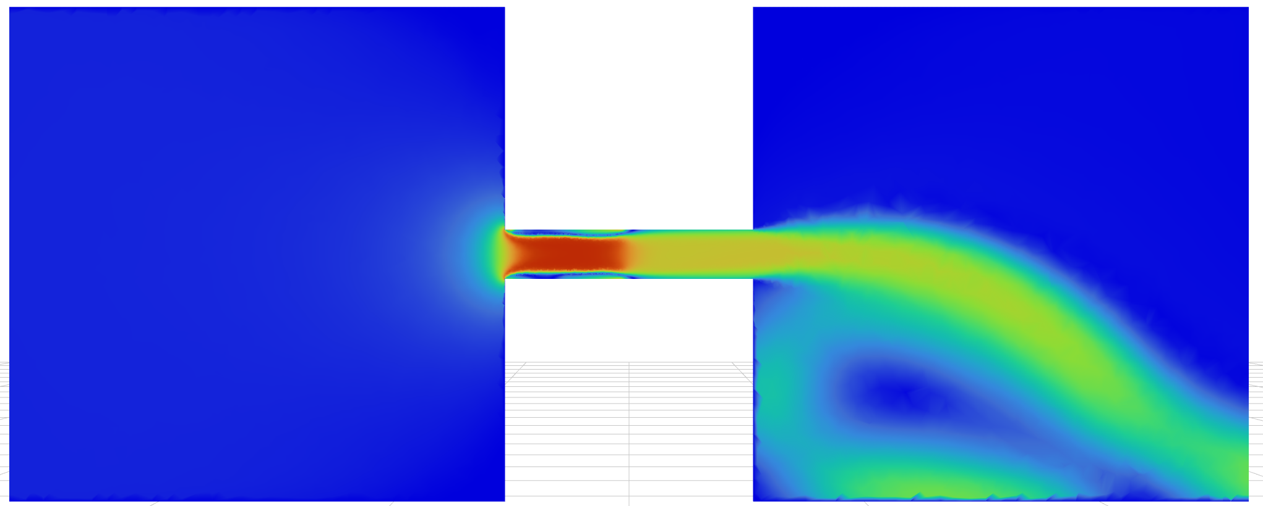
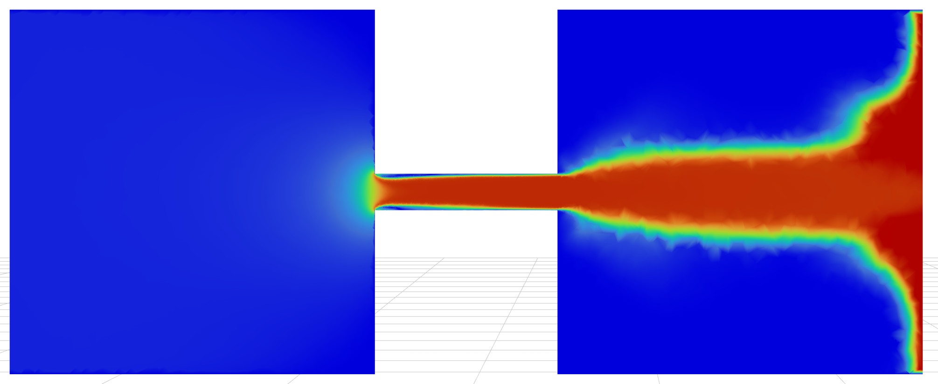
Post processing
Velocity plot
2 ΔP
0.5 ΔP
2.5 ΔP
1 ΔP
3 ΔP
1.5 ΔP
3.5 ΔP

Slide 7
Cd for 3.5 ΔP is nonphysical. This can be clearly seen from the velocity plot.
From 0.5 ΔP to 2.5 ΔP, the flow accelerates through the orifice and then diffuses downstream. The Cd is stable.
At 3ΔP, the core velocity is red (very high), but overall jet appears distorted, consistent with the flow becoming unstable due to a large vapour cloud.
At 3.5ΔP, the velocity is far higher than what the pressure drop should theoretically allow.

Slide 8
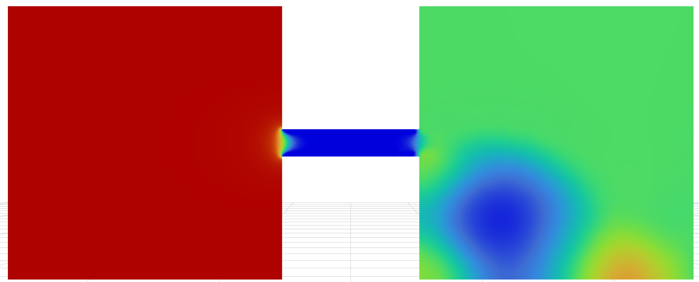

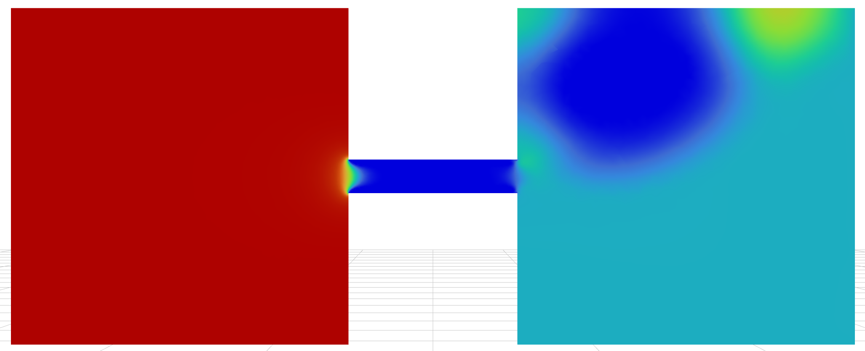
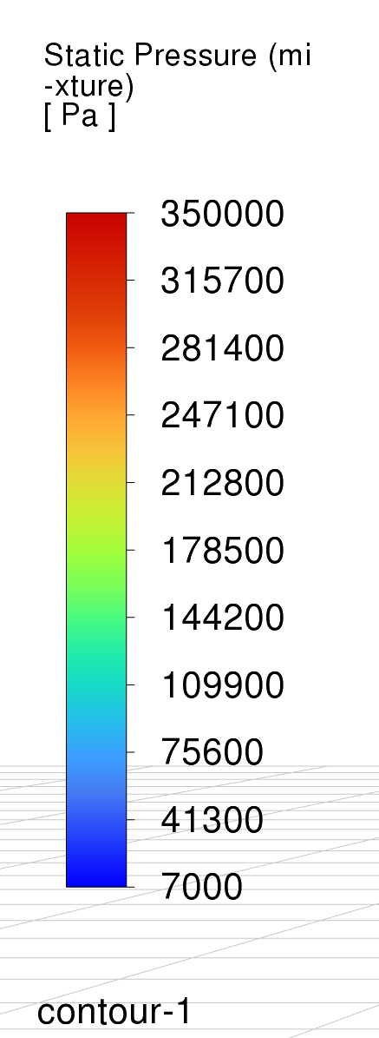

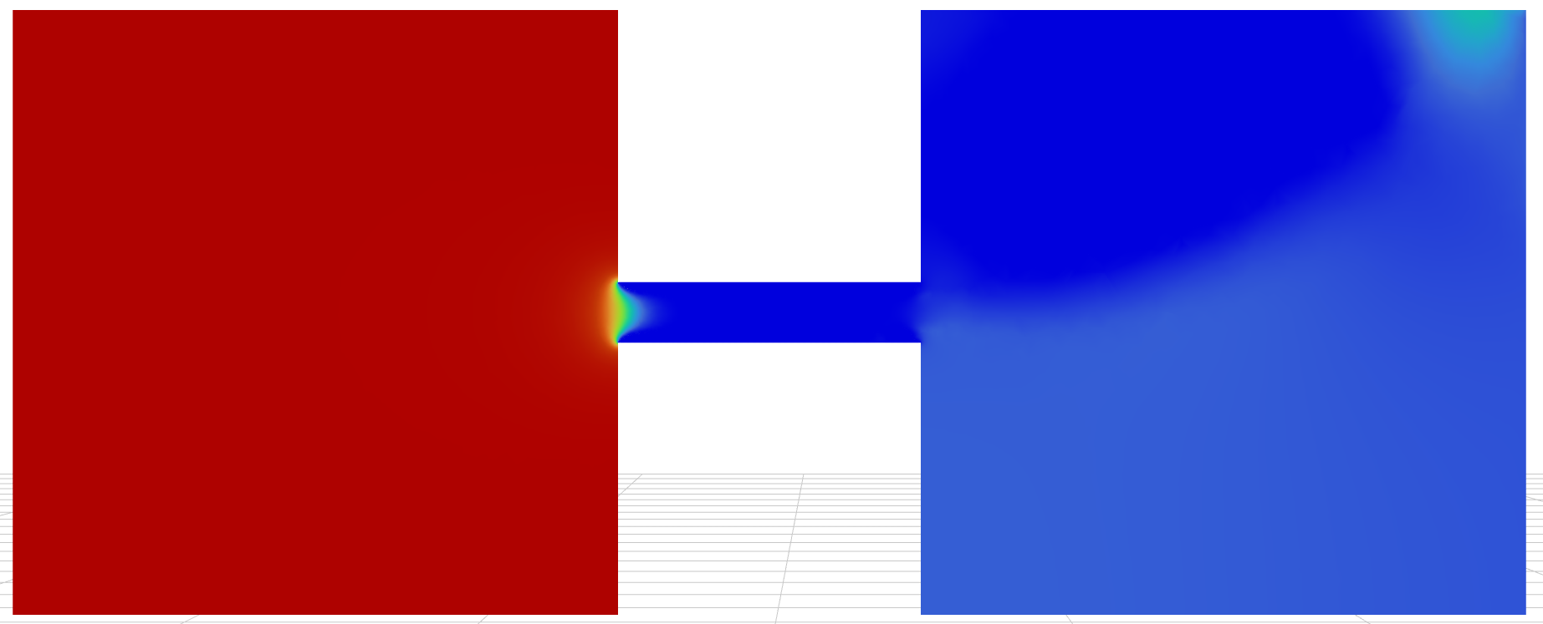
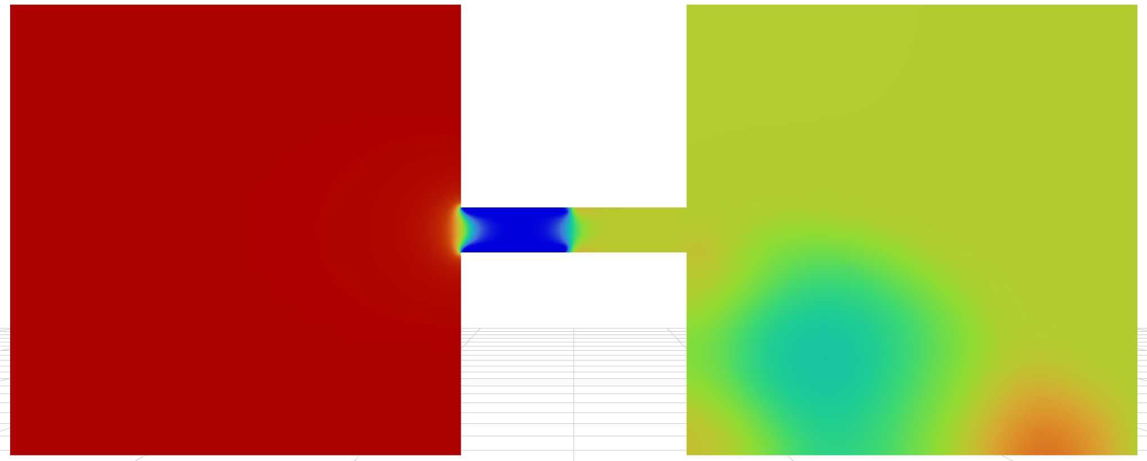
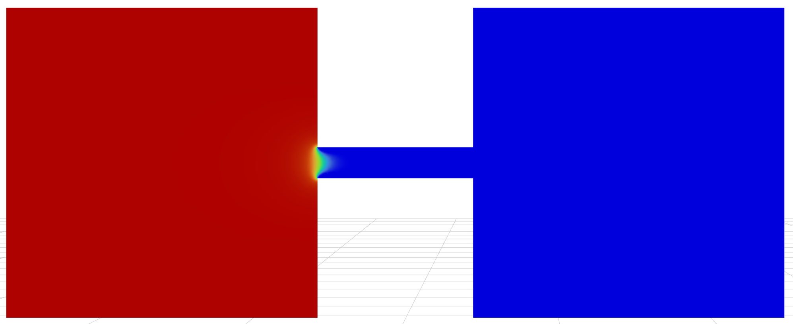
Pressure plot
2 ΔP
0.5 ΔP
2.5 ΔP
1 ΔP
3 ΔP
1.5 ΔP
3.5 ΔP

Slide 9
0.5ΔP to 2.5ΔP, pressure drops smoothly across the orifice and recovers partially downstream.
The downstream pressure is physically plausible.
At 3ΔP, the downstream pressure is very low ( dark blue), consistent with high velocity and choking.
At 3.5ΔP, the pressure downstream is completely dark blue, indicating it is completely vapour or a highly lower pressure. This non-physical drop causes different physics, which the solver cannot calculate.

Slide 10
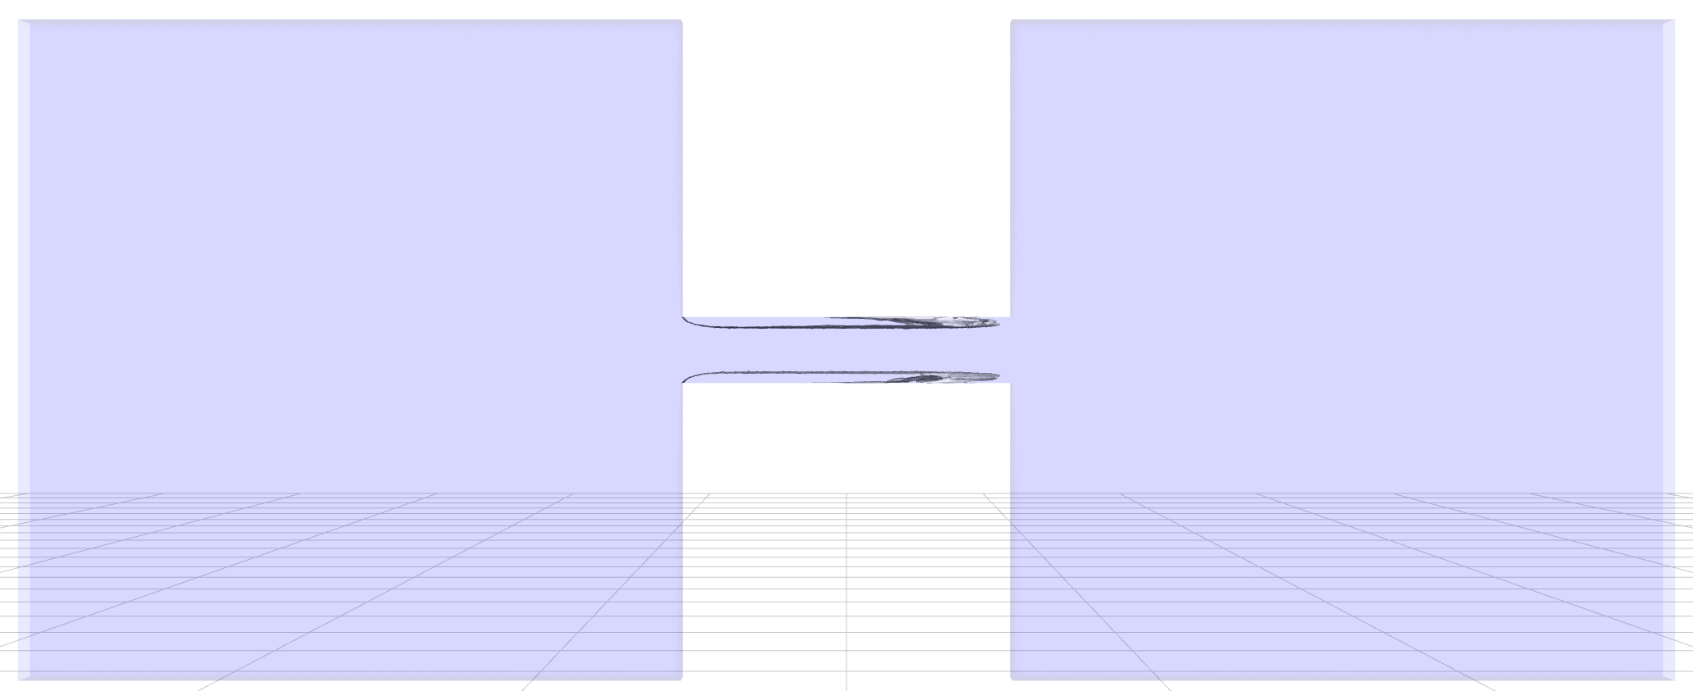
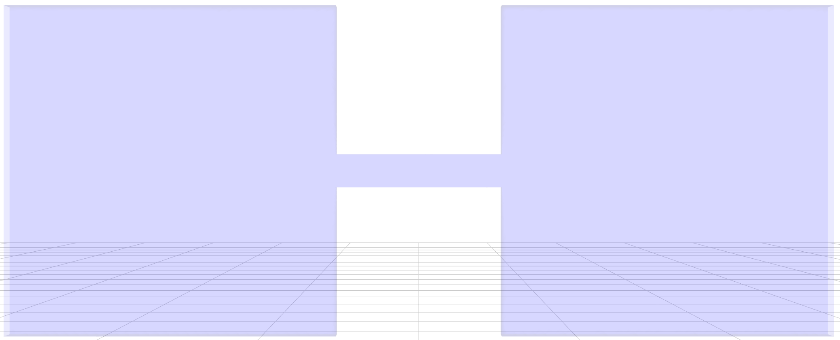
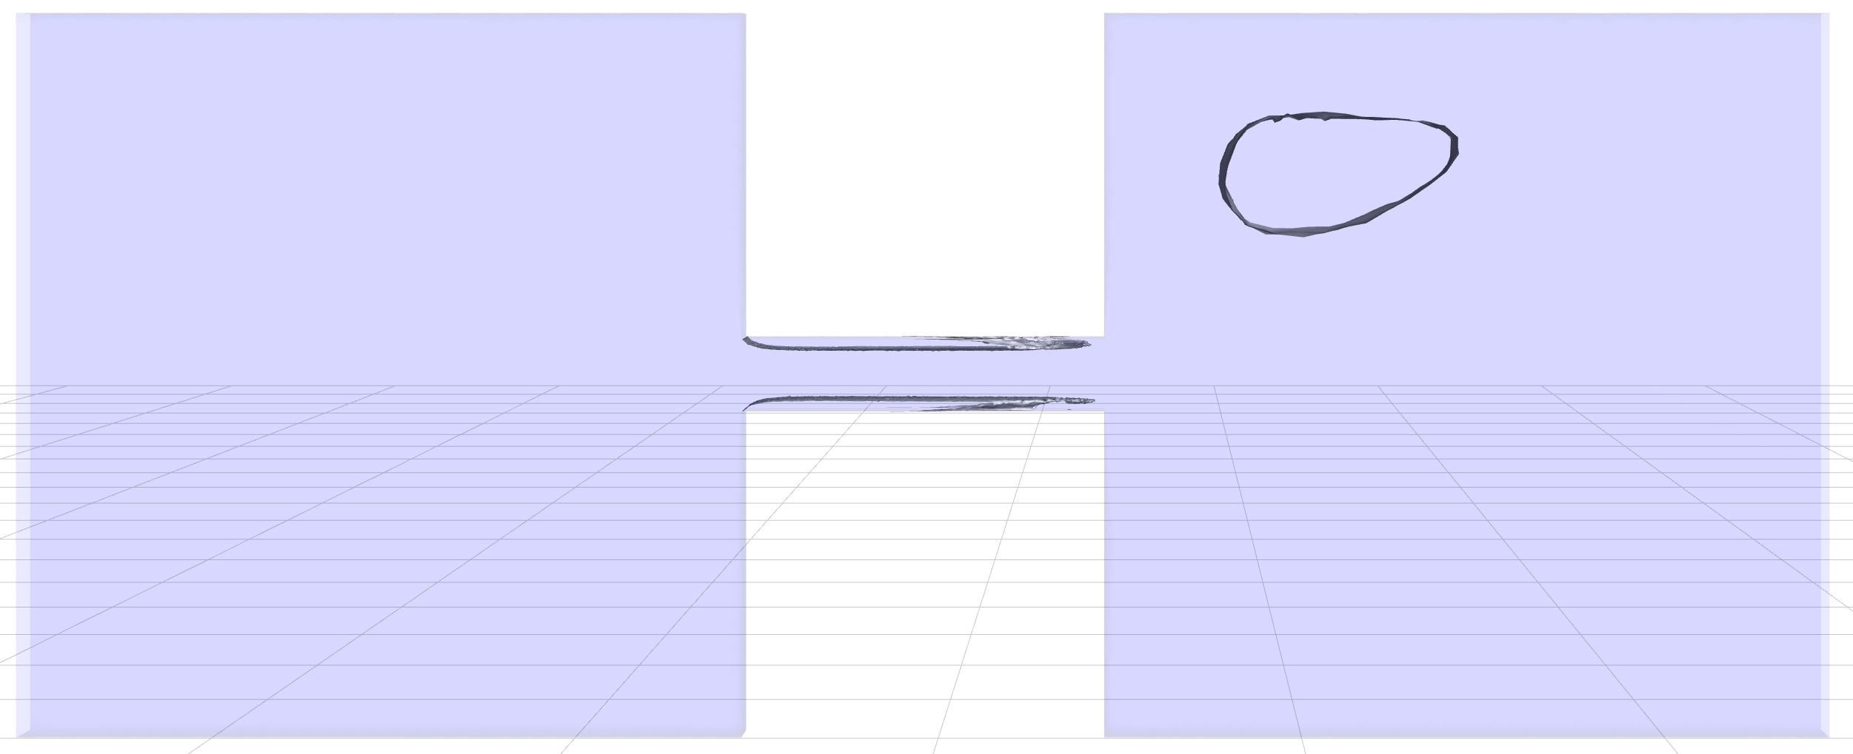
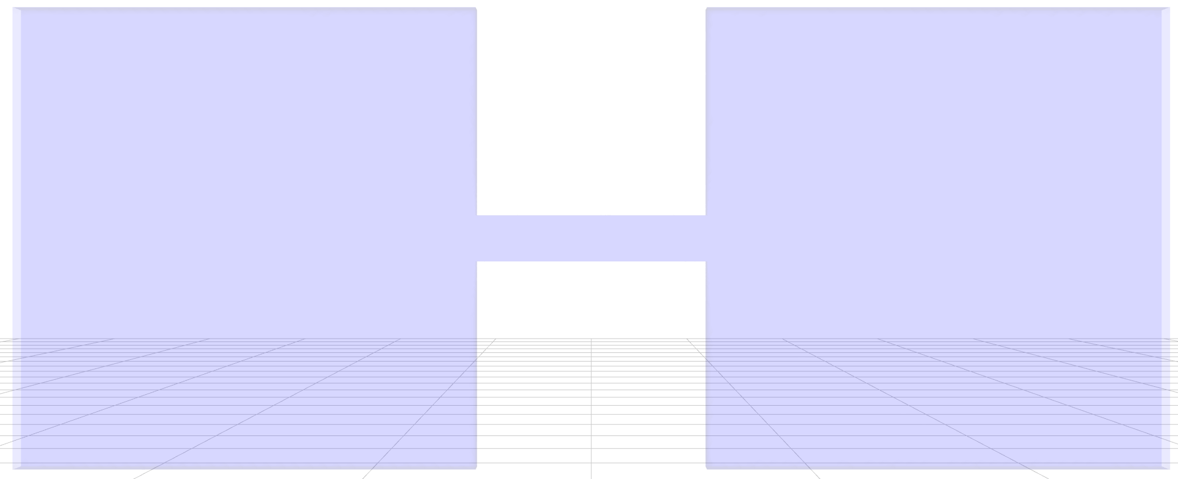
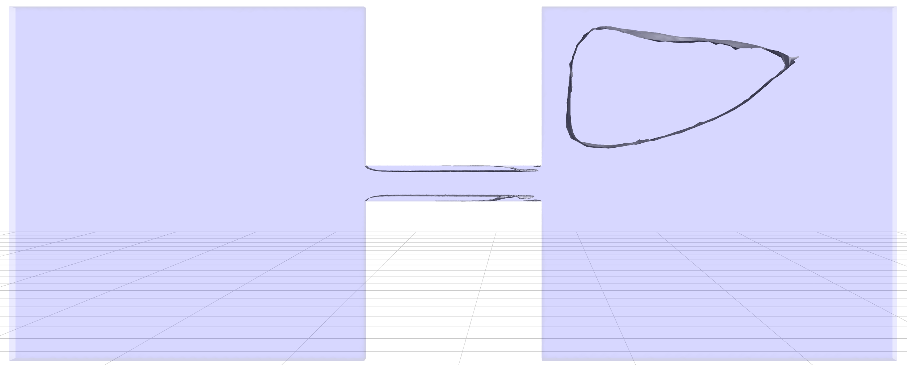
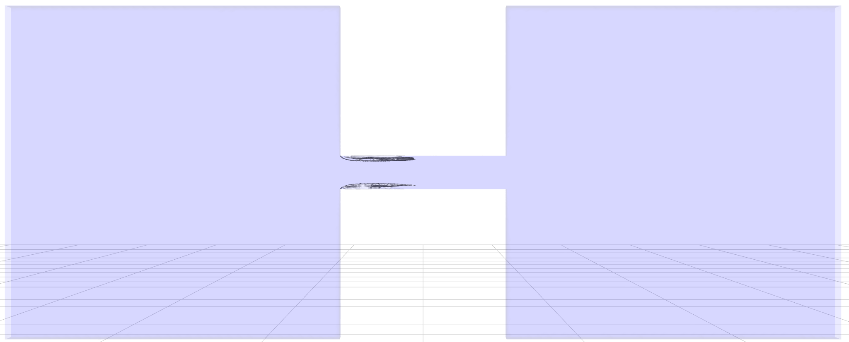
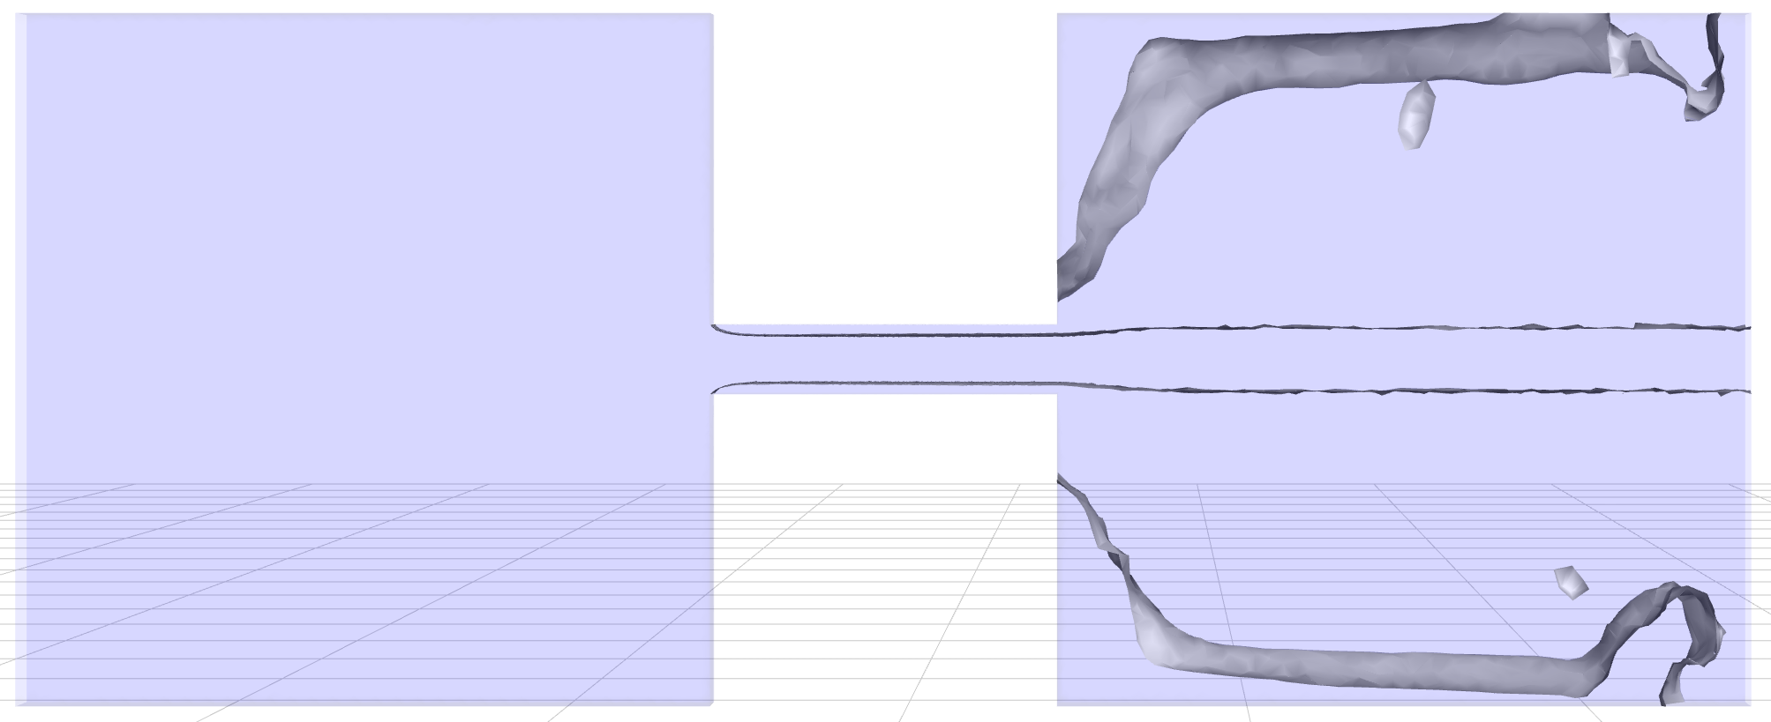
Vapor phase
2 ΔP
0.5 ΔP
2.5 ΔP
1 ΔP
3 ΔP
1.5 ΔP
3.5 ΔP

Slide 11
ΔP Multiple | Observation | Inference
0.5 to 1ΔP | No vapor is visible (pure liquid flow). | Cd​ should be constant, as observed in data (Cd​≈0.247).
1.5ΔP | A small, thin vapor cloud (cavity) starts to form just downstream of the sharp inlet corner. | Cavitation Inception. This is the point where the local pressure drops to the vapor pressure. Cd​ remains stable for now (Cd​≈0.286).
2ΔP | The vapor cavity is larger and more pronounced. | Cavitation is now well-established.
2.5ΔP | The vapor cavity has grown significantly. | Flow is now fully cavitating.
3ΔP | A very large, distinct vapor structure forms and detaches. | Choking Onset. The massive vapor cavity is restricting the flow, which aligns with the sudden, non-physical drop in the discharge cfd​ (and Cd​≈0.0186) due to flow instability or a choking calculation error.
3.5ΔP | The vapor cavity now fills the entire cross-section and extends far downstream. | Choked Flow/Supercavitation. The flow is completely choked, meaning the flow rate should no longer increase with increasing ΔP. The resulting Cd​≈5.61 is a severe numerical error caused by the single-phase solver failing to handle this massive phase change correctly (as previously discussed, predicting non-physical negative pressures).

Slide 12
The second plot on the right shows a typical Cd vs ΔP plot for an orifice. The first plot shows the actual simulation results with the error.
The plot shows non-cavitating flow in the 0.5 to 1 ΔP range, a cavitating flow till the 2.5 ΔP range and then choked flow at 3 ΔP and then at 3.5 ΔP; there is a numerical error of the solver.

Slide 13
Journal Script
/file/read-case-data "orifice.cas.h5"
ok
/solve/monitors/residual/print? yes
/solve/monitors/residual/plot? yes
/solve/report-definitions/add
mfr_outlet
flux
zone-names
outlet
()
quit
; --- Outlet 0.5 bar (50000 Pa) ---
/define/boundarypressure-conditions
set
pressure-outlet
outlet
()
mixture
gauge-pressure
no
50000
quit
/solve/initialize/hyb-initialization
yes
/solve/iterate 50
yes
/file/write-case-data "orifice0.5p.cas.h5"
yes
/file/write-data "orifice0.5p.dat.h5"
yes
; --- Outlet pressure 1.0 bar (100000 Pa) ---
/define/boundary-conditions
set
pressure-outlet
outlet
()
mixture
gauge-pressure
no
100000
quit
/solve/initialize/hyb-initialization
yes
/solve/iterate 50
yes
/file/write-case-data "orifice1p.cas.h5"
yes
/file/write-data "orifice1p.dat.h5"
yes
; --- Outlet pressure 1.5 bar (150000 Pa) ---
/define/boundary-conditions
set
pressure-outlet
outlet
()
mixture
gauge-pressure
no
150000
quit
/solve/initialize/hyb-initialization
yes
/solve/iterate 50
yes
/file/write-case-data "orifice1.5p.cas.h5"
yes
/file/write-data "orifice1.5p.dat.h5"
yes
; --- Outlet pressure 2.0 bar (200000 Pa) ---
/define/boundary-conditions
set
pressure-outlet
outlet
()
mixture
gauge-pressure
no
200000
quit
/solve/initialize/hyb-initialization
yes
/solve/iterate 50
yes
/file/write-case-data "orifice2p.cas.h5"
yes
/file/write-data "orifice2p.dat.h5"
yes
; --- Outlet pressure 2.5 bar (250000 Pa) ---
/define/boundary-conditions
set
pressure-outlet
outlet
()
mixture
gauge-pressure
no
250000
quit
/solve/initialize/hyb-initialization
yes
/solve/iterate 50
yes
/file/write-case-data "orifice2.5p.cas.h5"
yes
/file/write-data "orifice2.5p.dat.h5"
yes
; --- Outlet pressure 3.0 bar (300000 Pa) ---
/define/boundary-conditions
set
pressure-outlet
outlet
()
mixture
gauge-pressure
no
300000
quit
/solve/initialize/hyb-initialization
yes
/solve/iterate 50
yes
/file/write-case-data "orifice3p.cas.h5"
yes
/file/write-data "orifice3p.dat.h5"
yes

Slide 14
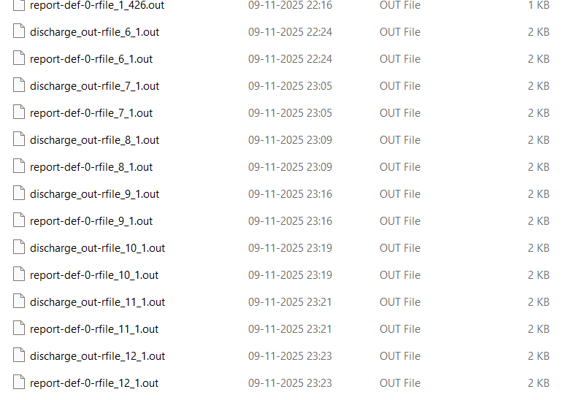
Every run produced a written file as dated and timed as shown.

Slide 15
Conclusion
The extreme nonphysical velocity is a direct consequence of single-phase CFD solvers calculating nonphysical, highly negative static pressures.
The instability is probably because of the presence of turbulence due to phase 2, and the solver is solving in steady state.
The simulation was run successfully to understand, plot and visualise the vapour phase.
It is easy to simulate multiple runs using the Journal script.
Automations save time in setting up the cases.

